Slide 1


REAL ESTATE
REGRESSION ANALYSIS
KRISTINA GRKOVIC
Notes:
Good afternoon! My name is Kristina and today I will be presenting a regression analysis on real estate data. We will explore how different factors influence home prices and provide recommendations for improving investment decisions.

Slide 2

OVERALL GOAL
Understanding Key Factors Influencing Sales Price of Homes
Notes:
The objective is to understand the factors impacting home prices to assist the real estate investor in setting appropriate prices for homes and making informed decisions about which properties to buy and how to renovate them.

Slide 3


DATA PROVIDED
Dataset contains 1460 homes sold between 2006 - 2010 with 27 columns:
21 numerical columns
6 categorical columns
We can build a multi linear regression model to help predict house prices and make data driven decisions about real estate investments.
Notes:
We analyzed data from 1,460 homes sold between 2006 and 2010. The dataset includes various features such as lot area, building type, kitchen quality, number of bathrooms, square footage, building type, year built and more. There are a total of 27 columns 21 of which are numerical and 6 categorical. This comprehensive dataset allows for a robust regression model to predict home prices and inform investment strategies.

Slide 4

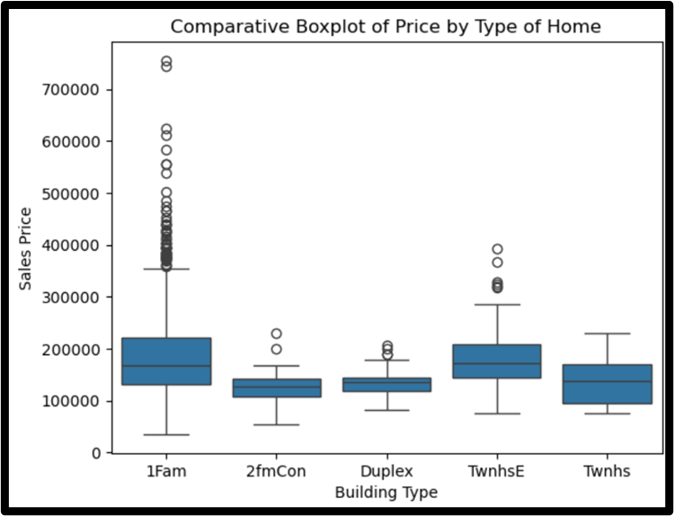
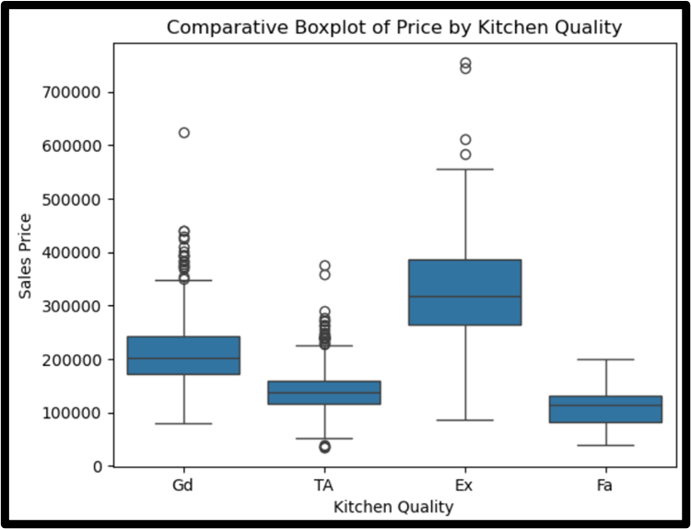
INITIAL INSIGHTS
Notes:
These box plots show the distribution of home prices based on building type and kitchen quality. We observe that different building types and kitchen conditions affect prices differently, providing an initial glimpse into the factors influencing home values.
For building types, we see the most variety with single family detached homes and townhouses. Their means are also higher than the other options, so we expect their price to be higher.
We can also se that homes with ‘Excellent’ kitchen quality generally have higher sales prices than those without. This is a key feature that homebuyers are willing to pay for.
These are just some initial insights that we see with the data, we can expect these factors to be significant later when we make the model.

Slide 5


MODEL BUILDING
Read and Clean Data
Fit Multiple Linear Regression against Sale Price
Log Transformation & Check VIF’s
Residual against Normal & Q-Q Plots
Use final model to make predictions ->
Summary Statistics
Automated Variable Selection
Add Categorical Variables as Dummy Variables
Notes:
Here is the timeline of steps that we taken to construct our prediction model.
We handled the initial data by reading and cleaning it. We removed missing values and outliers to cleanse the data and make it ready for analysis.
Next, we analyzed the basic statistics for insights. We did this by exploring the data with summary statistics through correlations & scatterplots, just to see if there are any obvious relationships between sales price and the variables.
Third we fitted a multiple linear regression model with all the numerical variables against sales price. This was our initial regression model.
Fourth we automated variable selection to retain significant variables. This just means that we went through the process of hand selecting variables that were the least significant in our model until all the variables left in the model were significant to predict sales price at a significance level of 5%.
Fifth we log transformed Sales Price in our model to deal with skewness in the distribution which improved the model's accuracy and checked the VIF’s. This just solidifies that our model is a good predictor, I will talk more about VIF’s in a later slide.
Sixth we added the categorical variables to our model using dummy variables. This allowed us to include variables like ‘Building Type’ and ‘Kitchen Quality’ in the regression without violating statistical assumptions.
And finally, we checked for multicollinearity by a residual analysis including a residual against normal plot and a Q-Q normal plot to ensure that no variables were overly correlated with each other and avoid redundancy in the model.
Once the model is complete and checked for accuracy, we can use it to make predictions for future house sales.

Slide 6
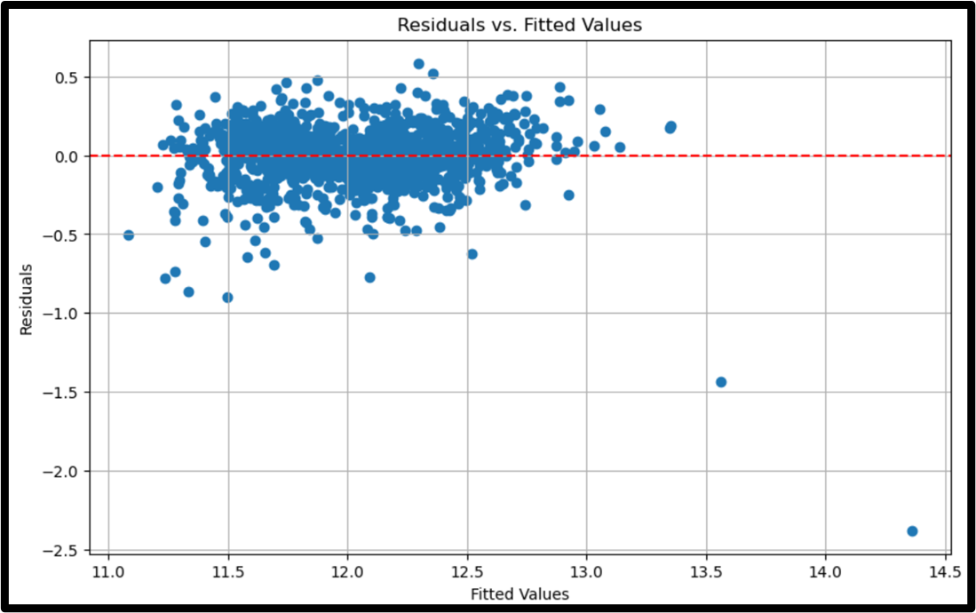
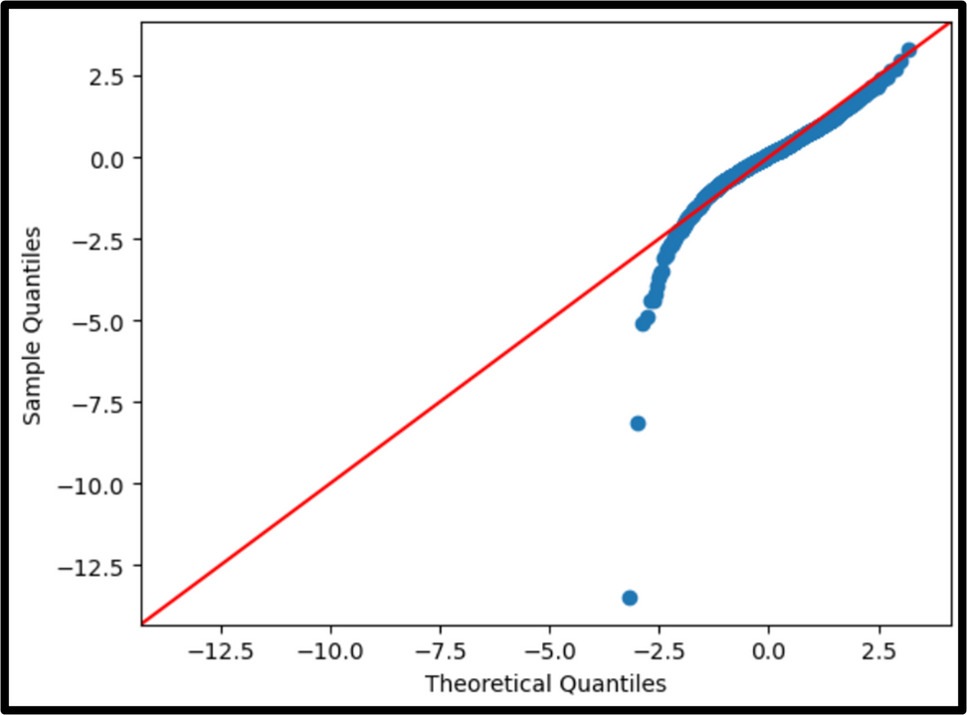
RESIDUAL & Q-Q PLOT
Coefficient of Detemination (R-Squared) = 83%
Notes:
After fitting the final model, we reviewed the residuals and Q-Q plots as well as the accuracy of our model.
Our model has an R-squared of 83%, indicating a strong fit, as it explains 83% of the variance in house prices. So, its super accurate! Great!
The residual plot shows that the variance of errors is fairly consistent across all fitted values, which means the assumption of homoscedasticity is met.
The Q-Q plot shows that after log-transforming Sales Price, the errors are approximately normally distributed. This improves the reliability of the model’s predictions.

Slide 7
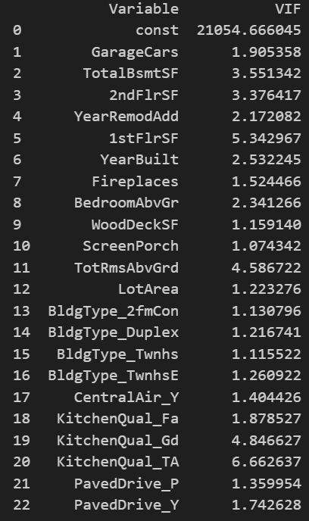
VIF ANALYSIS
VIF < 5 : good
5 <= VIF <= 10 : warning
VIF > 10 : bad
All the VIF’s look GOOD!
Notes:
Variance Inflation Factor (VIF) is used to measure multicollinearity between the independent variables. In our final model, all VIF values were below 10, indicating that multicollinearity is not a concern. This means that each variable brings unique information to the model, and they are not redundant.

Slide 8

KEY VARIABLES AFFECTING SALES PRICE
+
-
INCREASE PRICE
DECREASE PRICE
Central Air Conditioning
up to 13.01%
Garage Car Spaces
up to 8.68%
Fireplace
up to 6.06%
Non-Excellent Kitchen Quality
down by 22.73%
Townhouse Building Type
down by 14.57%
Unpaved Driveway
down by 7.14%
Notes:
This slide highlights the key factors influencing home prices based on our analysis.
Positive:
Homes with central air conditioning see a 13.01% price increase. It’s a valuable feature that adds comfort.
Each additional garage space boosts the price by 8.68%, reflecting the added value of extra parking.
Fireplaces contribute to a 6.06% increase in price, as they add both aesthetic and practical value.
Negative:
Non-excellent kitchen quality can reduce the price by up to 22.73%, highlighting the importance of a high-quality kitchen.
Townhouses are valued at 14.57% less than single-family homes, likely due to lower perceived privacy or space.
An unpaved driveway decreases the price by 7.14% compared to paved driveways, emphasizing the value of good driveway maintenance.
These insights can guide investment and renovation decisions to maximize home value.

Slide 9
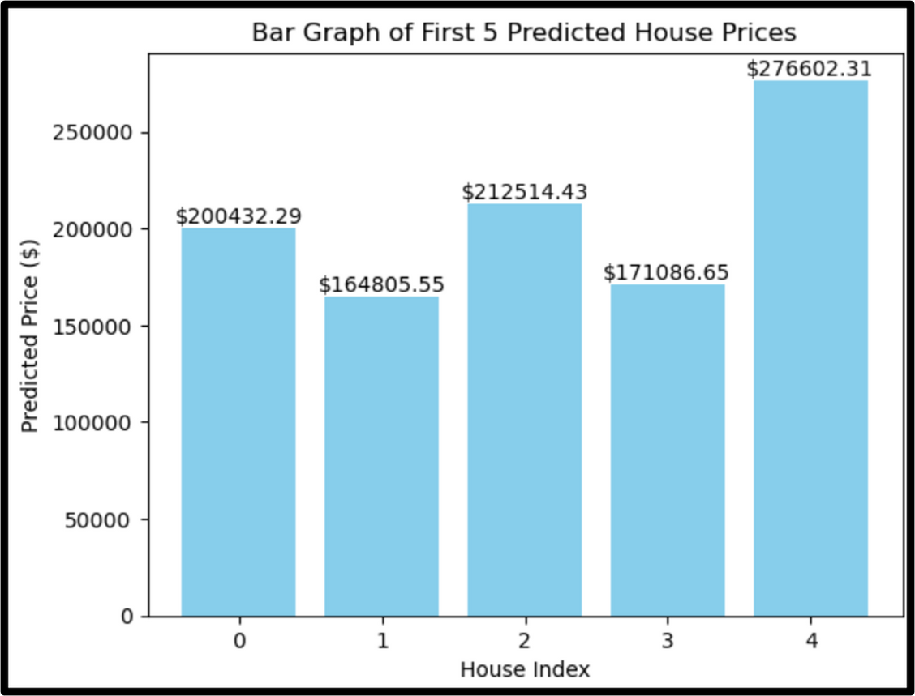
SAMPLE OF 5 HOMES
Here is a sample of 5 homes’ predicted prices that investor plans to sell in 2011.
Notes:
Using the final regression model, we predicted the sale price of five homes that are planned for sale in 2011. The predictions are based on the same set of variables used in the model.
As shown in the graph, the predicted prices ranged from $164,805 to $276,602, reflecting the individual characteristics of each home. These predictions provide a data-driven vasis for setting asking prices.

Slide 10
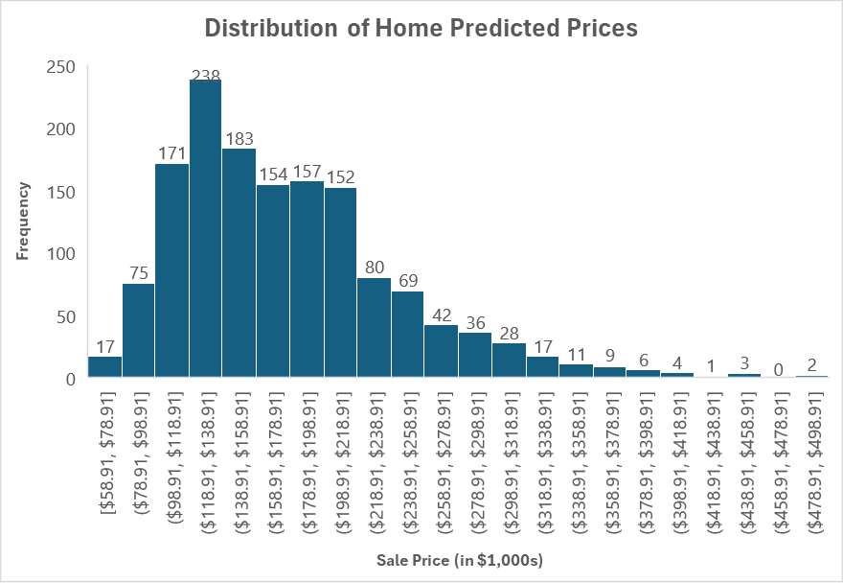
PREDICTING PRICES
Using the final model, we can predict the price of houses that are currently for sale. We get the following distribution:
Notes:
This histogram shows the distribution of home prices for all properties on the market in 2011. The distribution is right-skewed, suggesting that most homes are priced below the mean. The investor should expect to sell most homes in the range of $118,000 and $138,000.

Slide 11


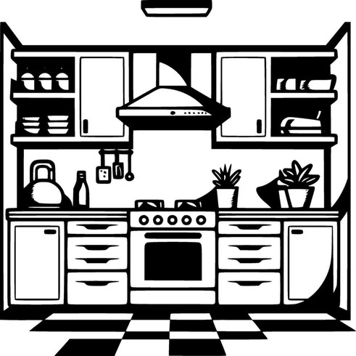
RECOMMENDATION FOR INVESTOR
1. Enhance Kitchen Quality
2. Install Central Air Conditioning
3. Improve Driveway and Exterior Features
Invest in high-quality kitchen renovations, including modern appliances, updated countertops, and cabinetry. Focus on making kitchen visually appealing and functional.
Budget for and install central air conditioning in properties lacking this feature. Emphasize the presence of central air in property listings and marketing materials.
Assess and upgrade driveways to paved or partially paved conditions. Enhance curb appeal with regular maintenance and minor improvements to landscaping and exterior features.
Notes:
In summary, the regression model offers valuable insights into which features of homes have the greatest impact on sales price. This can guide future renovation decisions and help in pricing homes more effectively.
Based on our analysis here are three actionable recommendations:
Upgrade Kitchen Quality:
Kitchens with higher quality finishes significantly enhance property value. Upgrades can attract higher offers and prevent price reductions due to poor kitchen quality. Aim for at least good condition to maximize price.
Install Central Air Conditioning:
Central air conditioning increases property value and comfort, making homes more attractive to buyers and potentially commanding a higher selling price. If possible, install or upgrade this feature in properties.
Improve Driveway and Exterior Features:
Well-maintained driveways and attractive exteriors improve first impressions and overall marketability, leading to higher property values. Consider paving driveways or improving their condition to enhance home appeal and value.

Slide 12

THANK YOU
Notes:
Thank you for your attention! ☺ I am available for any questions you might have regarding the analysis or recommendations.

Slide 13
REFERENCES
Machine Learning Code - “KellyBlueBook.ipynb”
Data Management Code - “RewardsDate.ipynb”
Open AI Chat GPT - code debugging and graphs
Notes:
Here are some resourced used for external research, including any relevant academic support examples consulted for the statistical analysis.

